Slide 1

AstroSage Analysis
AMIT KUMAR
29/12/2024

Slide 2

WHAT DO IS ASTROSAGE?
AstroSage is one of the most authentic astrology destinations for not only those who are seeking astrological assistance, but also for high-level astrological research and development on wide scale. It is a prolific astrological source for people to help them out from mundane questions to specialized queries. Our aim is to ameliorate those who are facing problems and betterment of humanity using divine science of astrology.

Slide 3
Problem statement
To optimize call center operations for AstroSage with a 1 crore investment.
The goal is to determine how to allocate this investment to maximize operational efficiency, customer satisfaction, and profitability.
This project will involve analyzing historical call data, performance metrics, and market trends to make informed decisions.

Slide 4
Data Overview
Top 10 Guru on Call , Chat Duration (minute) , Earning and Rating
Guru Name | Sum of Call time Duration ( Minute ) | Sum of Chat Duartion ( Minute ) | Sum of Astrologers Earnings | Average of rating
Astro Divya | 2358.846 | 4551 | 3696.9853 | 3.479166667
Astro Ruchi | 2252.6342 | 2737 | 10274.658 | 4.442728443
Astro Seema | 1531.569 | 2552 | 2690.8173 | 3.398347107
Astro Shalini | 2948.3075 | 1685 | 6807.6067 | 3.417108251
Astro Sonam S | 1978.9112 | 3180 | 2907.4947 | 3.719414894
Dr Balkrisna | 1323.6726 | 1898 | 15910.208 | 2.593886463
Tarot Ari | 1085.7309 | 1203 | 2222.5587 | 3.854166667
Tarot Bee Riya | 359.5957 | 2801 | 2178.7125 | 2.36204576
Tarot Rupika | 936.616 | 2031 | 2198.75 | 2.846560847
Usha Siingh | 186.8486 | 520 | 2870.2667 | 2.15
Total Consultation | 28027
Net Amount | 213987.3153
Total Calls | 8508
Net Amount (Call) | 168442.035
Total Chat | 19514
Net Amount (Chat) | 45494.68333

Slide 5
Data cleaning and analysis or methology
Data Cleaning Process
Data Analysis Techniques
Data Inspection: Review data for completeness and accuracy.
Handling Missing Values:
Imputation (Not available (N/A), and ‘0’)
Removing Duplicates: Identify and eliminate duplicate entries.
Standardization: Ensure consistent formatting (e.g., date formats, categorical variables).
Descriptive Analysis: Summarize historical data to understand trends and patterns.
Predictive Analysis: Use statistical models to forecast future call volumes and customer behavior.
Sentiment Analysis: Analyze customer feedback to gauge satisfaction levels.

Slide 6
Identifying Performance Gaps
AstroSage has been facing challenges in maintaining optimal call center performance.
As per given Data :
Declining customer satisfaction scores | Inconsistent call volumes. | Variability in agent performance.
Average Customer satisfaction is very low. Average Rating is 2.93 , which is very low . | Daily Call volume is inconsistent. Total change in Call volume is in negative , and average change is in negative. | Overall Agent performance is poor. Average performance of guru is not fair .
AstroSage's performance compare to its competitor, AstroGuru
To compare AstroSage's performance to its competitor, AstroGuru, we can analyze several key performance metrics typically used in call center operations.

Slide 7
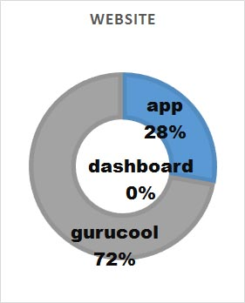
Traffic website
According to given data
Gurucool have more
Traffic than App
User Traffic ( Platform )
Gurucool App Dashboard

Slide 8
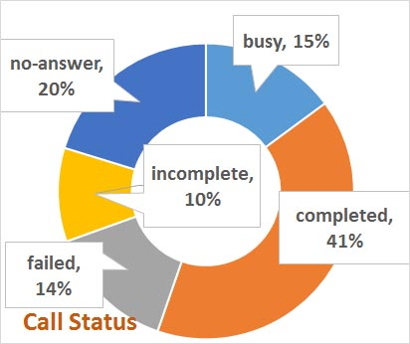
User call status
According to given data Only 41% call are completed Need to improve call completing percentage by providing automate IVR call for initial engage and hire more agent to increase call completing
Complete
Incomplete
Busy
No-answer
Failed

Slide 9
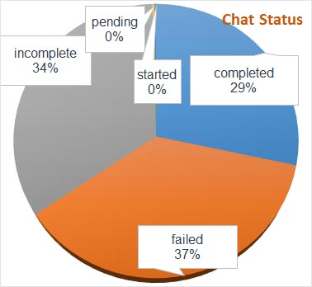
User chat status
According to given data Only 29% chat are completed which is very low Need to improve chat completing percentage by providing automate AI Chat support for initial engage and improve AI Chat Bot increase chat completing
Complete
Incomplete
Failed
Pending
Started

Slide 10
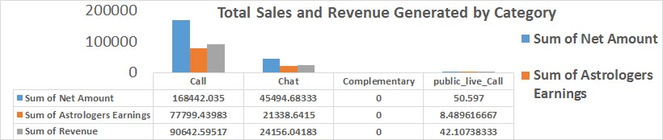
Total sales and revenue generated by category
According to given data Top sales category is
Call also on Revenue and
Astrologer Earning. Calls category is very important segment to improve.

Slide 11
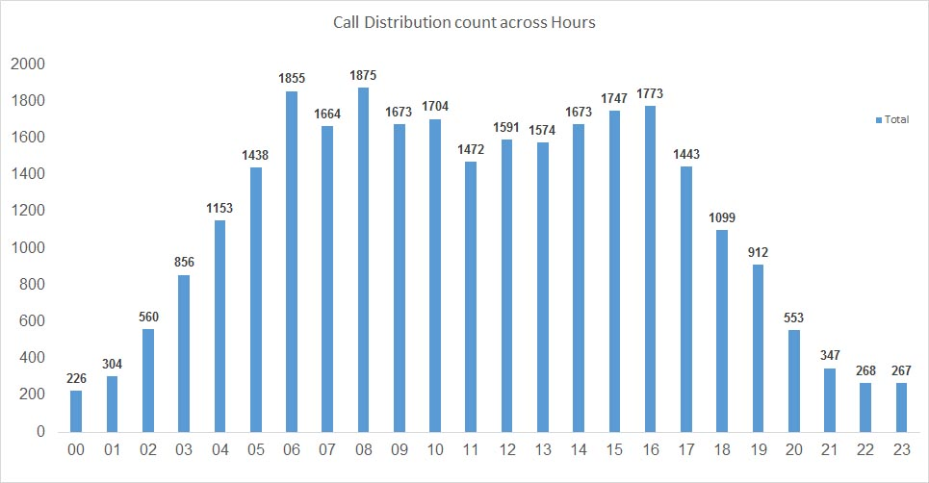
Total call distribution across hours
Call peak hour must be focus on
Peak hour to engage more user and generate
Maximum revenue.

Slide 12
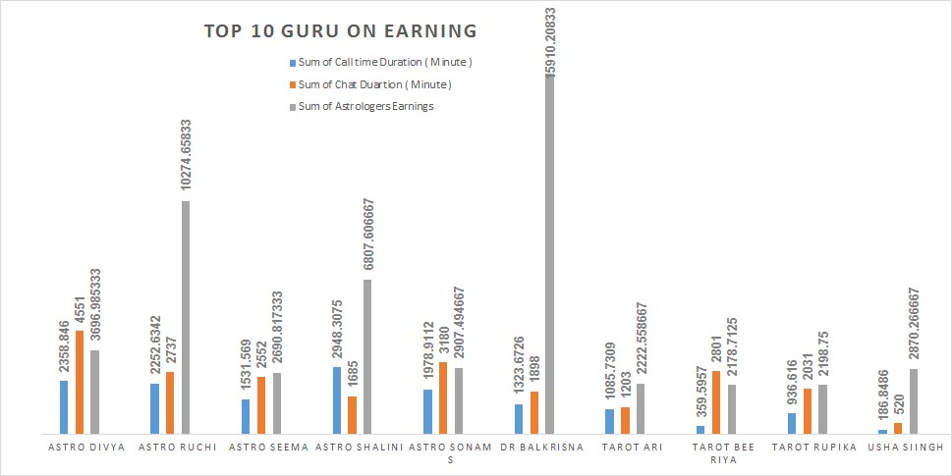
Top 10 guru
Represents the top 10 guru on earning based on various criteria like "sum of astrologers earnings", "sum of chat duration" and "sum of call time duration".

Slide 13
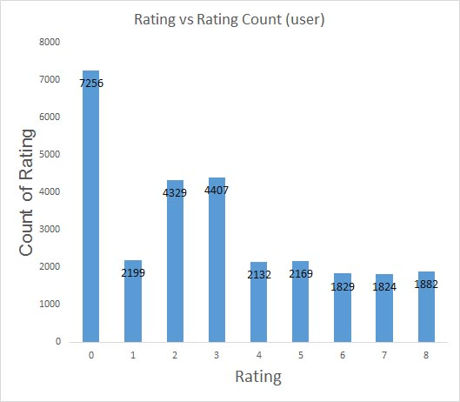
Rating vs count of rating
According to data Overall rating is very poor it show customer satisfaction is Low. Need to improve customer satisfaction by providing
Free chat through AI Chat Bot .

Slide 14
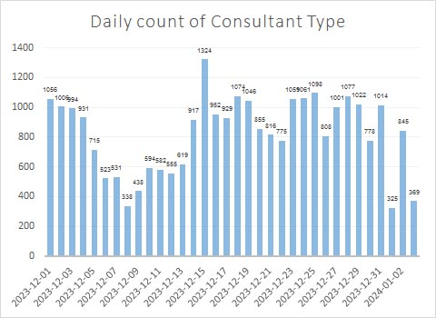
Daily count of Consultant Type
According to Given Data
Daily consultant (including call, chat..)

Slide 15
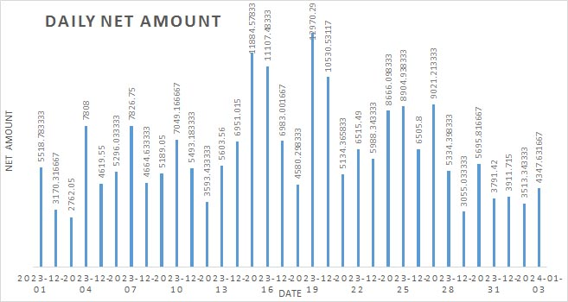
Daily net Amount
According to Given Data
Sum of Daily net Amount
( including call , chat )

Slide 16
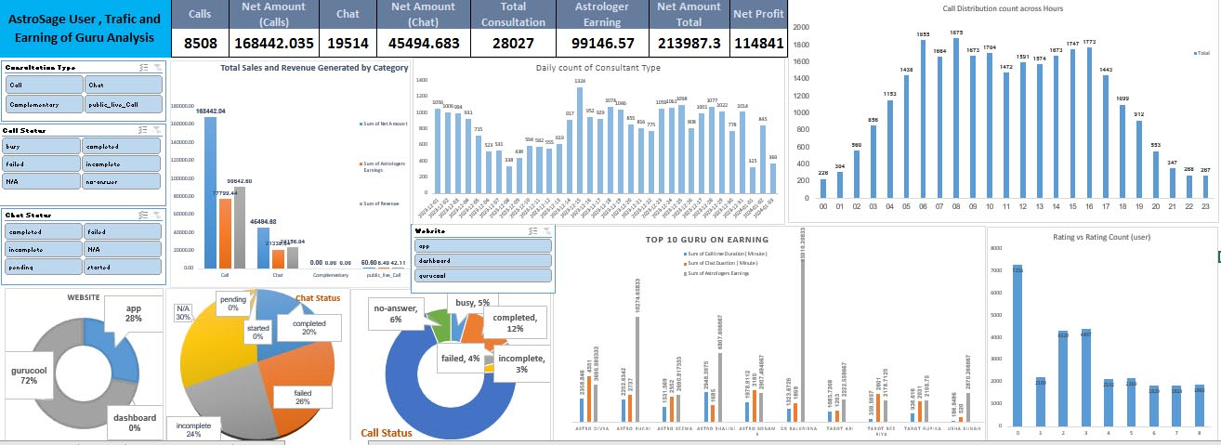
Astrosage dashboard

Slide 17
Key Insights Summary
AstroSage has lower average call volumes compared to AstroGuru.
Customer satisfaction is declining, indicating potential service issues.
Agent performance varies significantly, with some agents excelling
while others lag behind.
Possible Key Factors
Based on call centre operations, the following data attributes might impact customer satisfaction:
Call Duration: Shorter or optimal durations may indicate efficient resolution.
Agent Performance: Metrics like the number of calls handled, agent rating, and expertise (e.g., Guru Name).
Call Channel and Type: Free vs. paid calls, chat vs. voice calls, or specific consultation types.
Call Status: Successful resolution or unresolved queries (e.g., refund or escalation cases).
Time of Call: Off-peak vs. peak handling efficiency.
Region: Localization or language support preferences

Slide 18
Suggestion
Suggestions for Improvement Based on Findings
Agent training:
Focus training on areas that correlate with high satisfaction, such as consultation effectiveness or reduced resolution time.
Optimization of call duration:
Identify the optimal duration range where satisfaction is highest and aim for efficiency within that range.
Feedback integration:
Use customer feedback to identify pain points and success areas for iterative improvement.
Strategic resource allocation:
Deploy high-performing agents during critical time slots or for complex cases to maintain satisfaction levels.

Slide 19
Suggestion
Satisfaction score affect the rating if any customer is not satisfied we can’t say that they will provide positive feedback to us . If someone little bit satisfied then they also not provide 5 out of 5 rating , we have to ensure that their problem and why they are giving low rating , after taking feedback we can improve that. Statistical Analysis:
Perform regression analysis with satisfaction scores as the dependent variable and other factors as independent variables. The coefficients and p-values will indicate the significance of each factor.
Practical Validation:
Compare satisfaction scores for high-rated calls (e.g., 4-5 stars) vs. low-rated calls (e.g., 1-2 stars). A clear difference in factors like call duration or agent can validate the impact.

Slide 20
Based on call centre operations, the following data attributes might impact customer satisfaction:
Call duration: shorter or optimal durations may indicate efficient resolution.
Agent performance: metrics like the number of calls handled, agent rating, and expertise (e.g., Guru name).
Call channel and type: free vs. Paid calls, chat vs. Voice calls, or specific consultation types.
Call status: successful resolution or unresolved queries (e.g., Refund or escalation cases).
Time of call: off-peak vs. Peak handling efficiency.
Region: localization or language support preferences.

Slide 21
Conclusion
AstroSage faces challenges in call volume, customer satisfaction, and agent performance.
Immediate attention is needed to address these issues to remain competitive.
Suggestions for Improvement Based on Findings
Agent Training:
Focus training on areas that correlate with high satisfaction, such as consultation effectiveness or reduced resolution time.
Optimization of Call Duration:
Identify the optimal duration range where satisfaction is highest and aim for efficiency within that range.
Feedback Integration:
Use customer feedback to identify pain points and success areas for iterative improvement.
Strategic Resource Allocation:
Deploy high-performing agents during critical time slots or for complex cases to maintain satisfaction levels.

Slide 22
THANKS
Presented By
AMIT KUMAR

